Slide 1
Airbnb Tableau Dashboard

Slide 2
About This Project
Here in this project, there is dataset from which insights are drawn which can be useful to gain vauble Airbnb market data for new or existing host

Slide 3
Insights
What is the average Price Per Bedroom?
Which zipcode provide the highest and lowest price?
How many listings are in the are?
Best and worse revenue months

Slide 4
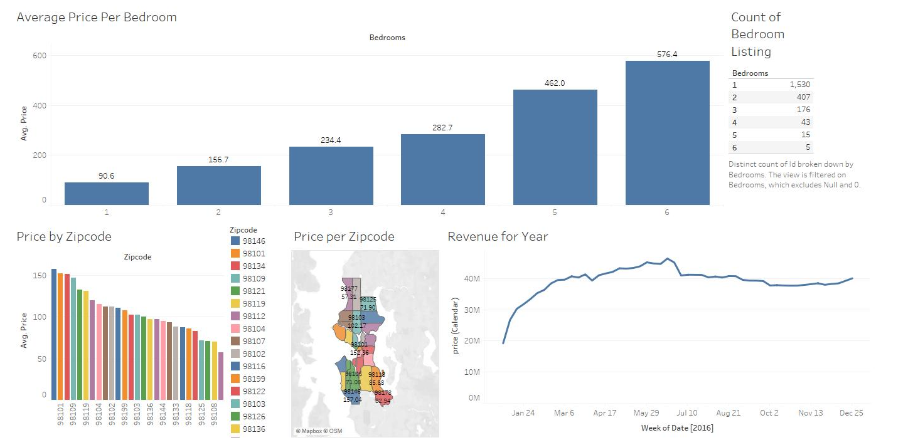

Slide 5
Hotel Tableau Dashboard
Eric Martin

Slide 6
About the Project
Sales Departments deal with various revenue related work of the company. Here in this project, there is dataset from which insights are drawn which can be useful to gain knowledge about the market.

Slide 7
Insights To Be Found
What countries are the leaders in hotel bookings?
What is the total number of bookings per agent?
Of the bookings per agent how many were check-out, canceled, or no-shows (reservation status)?
What is the leading market segment for generating bookings?

Slide 8
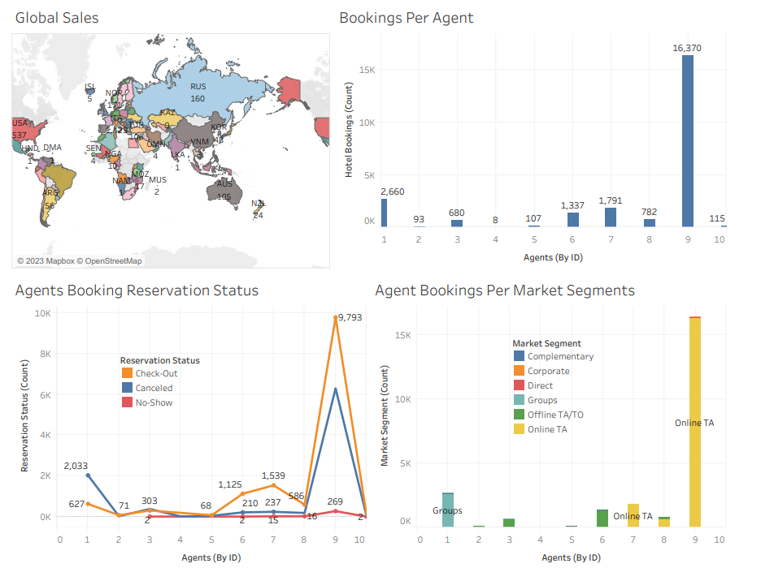
Hotel Bookings Tableau Dashboard

Slide 9
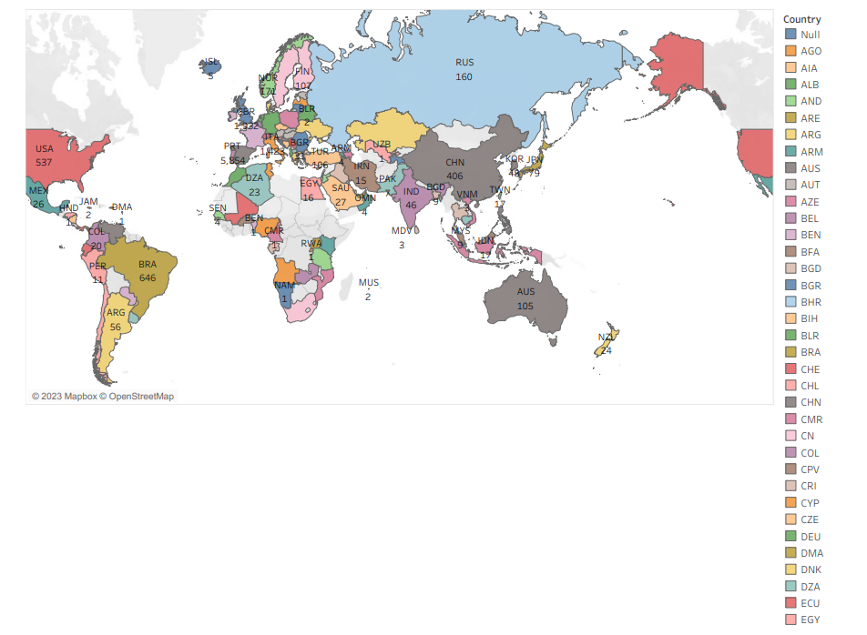
Global Sales

Slide 10
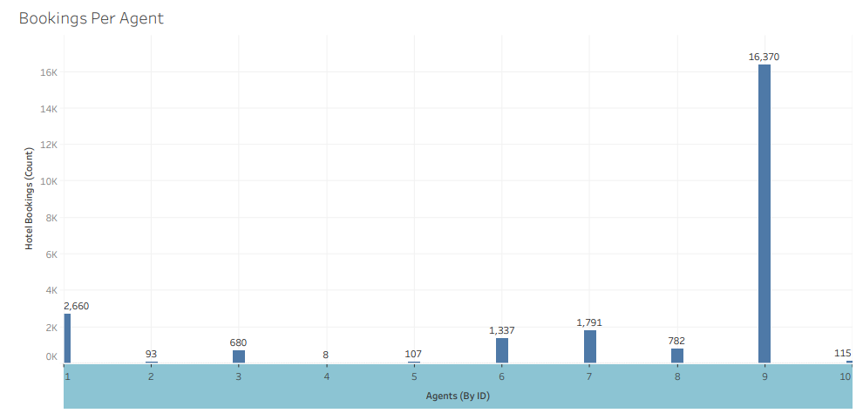
Bookings Per Agent (By ID)

Slide 11
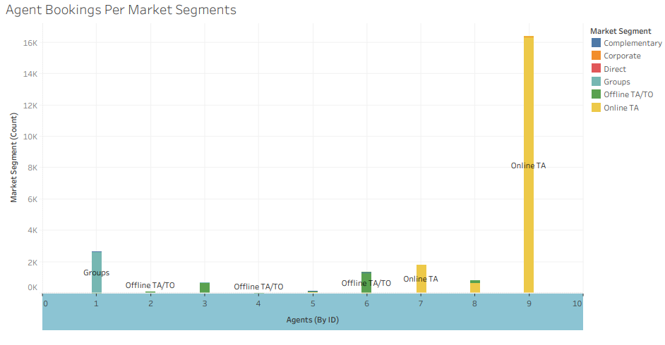
Agents Bookings Per Market Segment

Slide 12
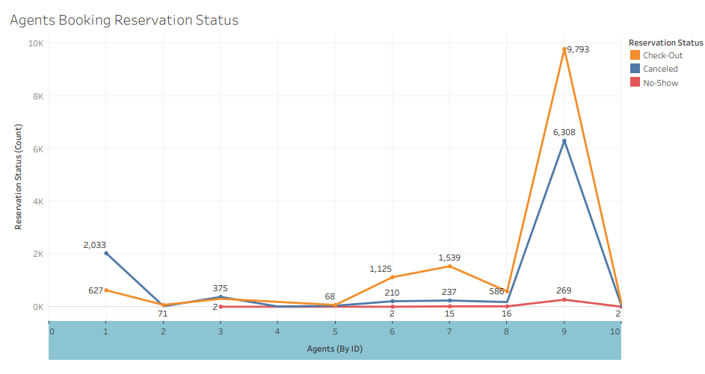
Agents Bookings Reservation Status

